Slide 1


Project name: Mesh Walkie Talkies Team members: Cole Cieslewicz, Ryan Haag, Jaiah Steele, Junsu Yeo
Project sponsor: Giuseppe Rizzi (TI)
ECEN 403

Slide 2
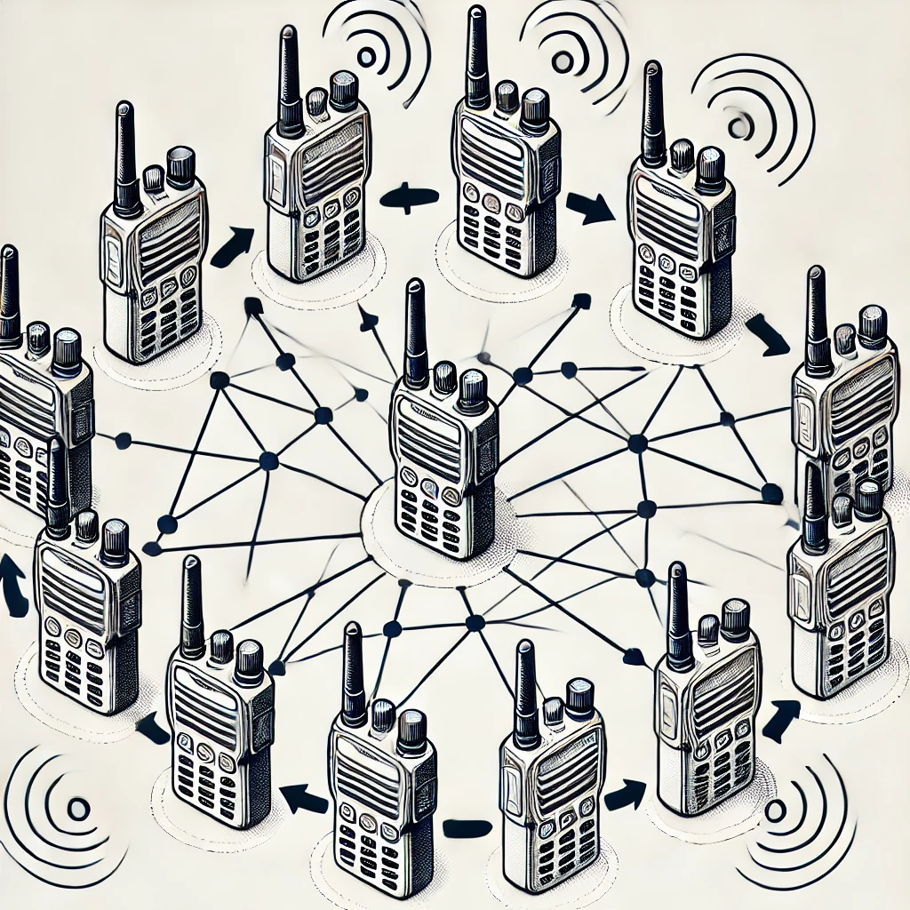
Project description
Problem statement: Current conventional walkie-talkies face limitations in range and connectivity, which often requires users to be within a fixed distance to maintain clear communication. This restriction can hinder effective communication in scenarios like search and rescue, outdoor activities, or team coordination in large areas.

Slide 3
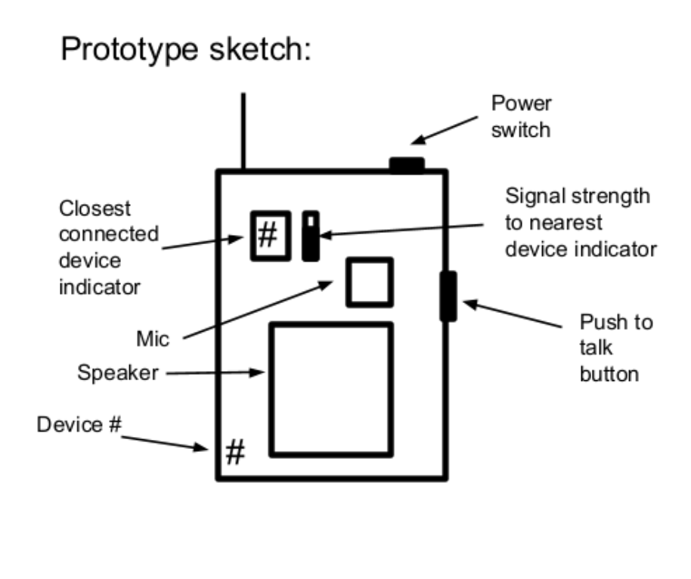
Project description
Solution proposal: Build a set of wireless battery-powered walkie talkies that transmit/receive low latency audio between all devices using a connected mesh network to, when needed, relay the signal between devices that are too far apart to otherwise communicate.

Slide 4
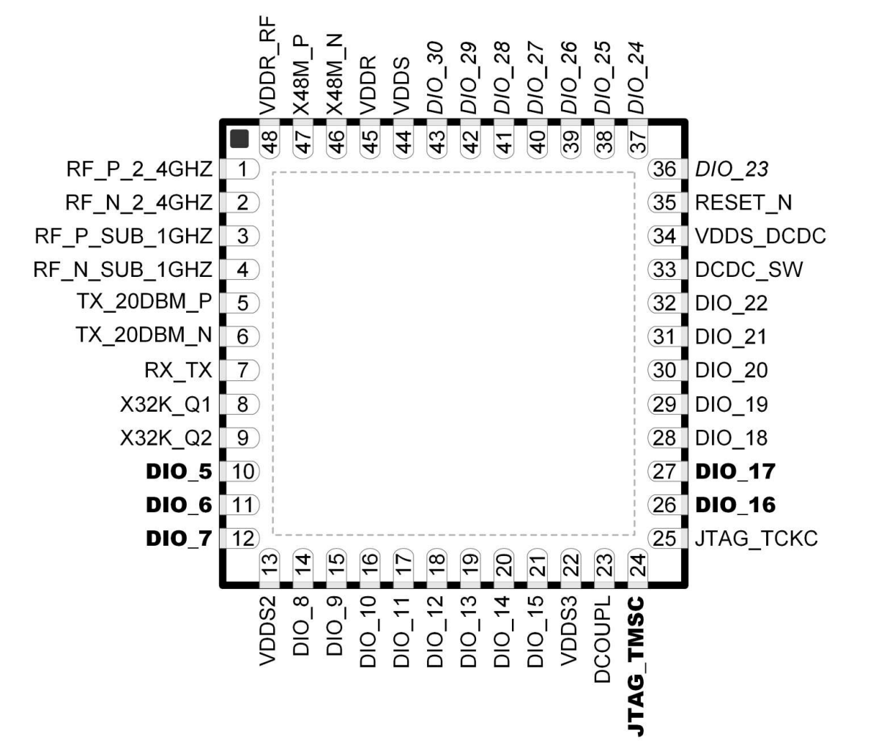
Texas Instruments CC1354P10
High-Performance Multi-band Wireless MCU With Integrated Power Amplifier
The device is optimized for low-power wireless communications, with on-chip over-the-air (OAD) update capability. It enables long range and reliable communication in building security systems, HVAC, smart meters, medical, wired networking, portable electronics, home theater & entertainment, and connected peripherals markets.
The CC1354P10 device is part of the SimpleLink™ MCU platform, which consists of Wi-Fi®, Bluetooth Low Energy, Thread, Zigbee, Sub-1 GHz MCUs.

Slide 5
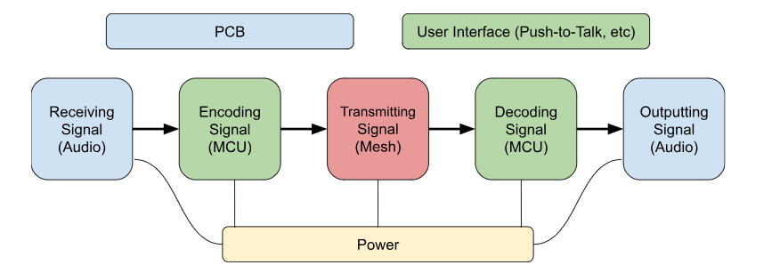
Subsystem Breakdown
Blue: Ryan Haag Green: Jaiah Steele
Red: Cole Cieslewicz
Yellow: Junsu Yeo

Slide 6
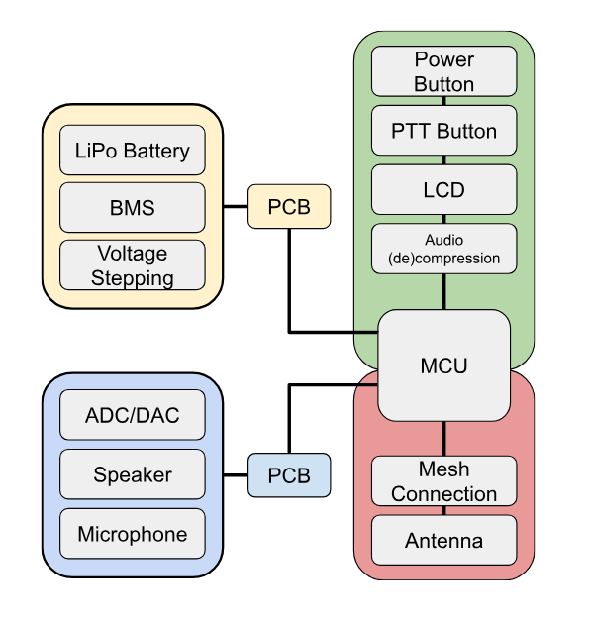
Technical System Breakdown
Blue: Ryan Haag Green: Jaiah Steele
Red: Cole Cieslewicz
Yellow: Junsu Yeo

Slide 7
Task partition
Jaiah: Develop Push-To-Talk button with LCD as well as implement the Opus Codec to compress digital audio to enable packetization to be sent via Wi-Sun.
Junsu: Voltage stepping to ensure the MCU, peripherals, and other components are receiving the appropriate power that it needs. Recharging a Single Cell LiPo Battery with a charging IC as well as proper Battery Protection IC.
Ryan: Ensure the microphone and speaker work properly with the MCU’s DAC and ADC. Design the PCB that consists of the MCU, peripherals, and other components.
Cole: Work with the MCU to ensure instant communication; implement the mesh network between devices, which includes sending and receiving data packets simultaneously.

Slide 8
Subsystem progress in past 1.5 months
Junsu: Finished the subsystem introduction project. Bought a 3.7V 2500mAh LiPo Battery capable of running the walkie talkie for over 24 hours. Researched the tradeoffs for different charging and battery protection ICs. Began creating schematics on Altium.
Ryan: Finished the Subsystem Introduction Project. Researched and purchased a microphone and speaker for walkie talkie. Beginning the design of the PCB and determining the amplification of microphone and speaker.
Jaiah: Finished subsystem introduction project. Started development on LCD’s and downloaded Opus Codec into Code Composer Studio.
Cole: Nearly finished subsystem introduction project. Now getting multiple MCUs to communicate with each other (send small packets back & forth) via UART, before moving on to the Wi-SUN protocol.

Slide 9
Design Considerations
Item Utilized | Purpose | Pros | Cons | Alternatives Considered
Wi-SUN | Mesh networking capabilities required for devices to function as desired | Mesh-first Large range TI-compatible | Less mature in consumer market Low data rate | Zigbee Thread Bluetooth Mesh
GeeekPi 2-Pack I2C 1602 LCD Display Module 16X2 | User interface display to show when the walkie is on, transmitting, and receiving as well as who it is receiving from | Cost i2c protocol interface to reduce the occupation of I/O ports Two rows for displaying data | Uses arduino software library; must be adapted to CCS | NHD-0116AZ-RN-GBW-ND
Opus Codec | Used to ensure that the audio packets are small enough to be sent efficiently within the bandwidth limitations of the Wi-SUN protocol. | Optimized for Low-latency and real time applications Good audio quality even at low bitrates Adaptive for network conditions Open source | Higher complexity, more processing power | Speex G.729 AAC

Slide 10
Design Considerations
Item Utilized | Part | Pros | Cons | Alternatives Considered
SPH11C3LR5H-1 | Microphone | 32 Hz ~ 20 kHz 68.5dB S/N Ratio Omnidirectional | Has a high sensitivity | SPH0641LU4H-1
K 50 FL - 8 OHM | Speaker | Low impedance Large diameter Low power usage | Lower dBA efficiency | SP520104-1 GF057
BQ25628E | Charging IC | 2A Charging Current USBC Buck Converter CC/CV | No Fuel Gauge (SoC) | BQ24075T TP4056 Both do not support USBC
BQ27Z746YAHR | Battery Protection IC | OVP 4.2V UVP 3V OCC OCD OT 45℃ Fuel Gauge | Very complex design Lots of components | BQ29705 No thermal protection BQ298218 Factory set values

Slide 11
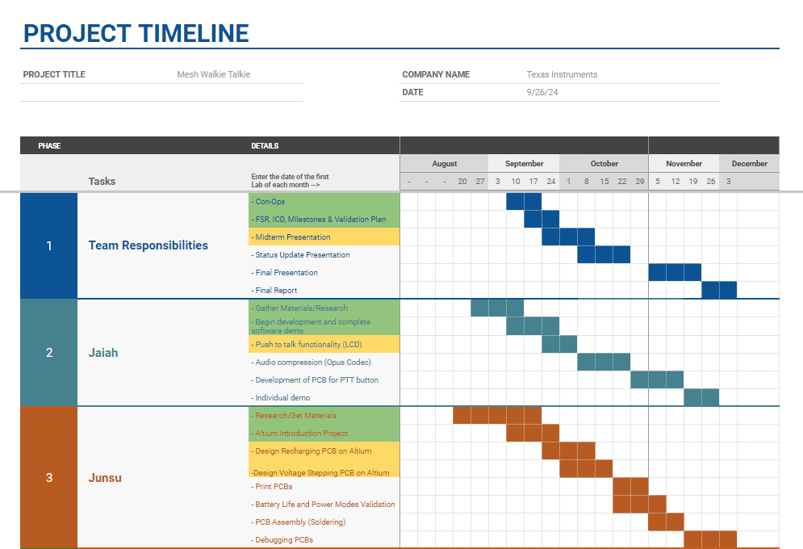
Execution Plan

Slide 12
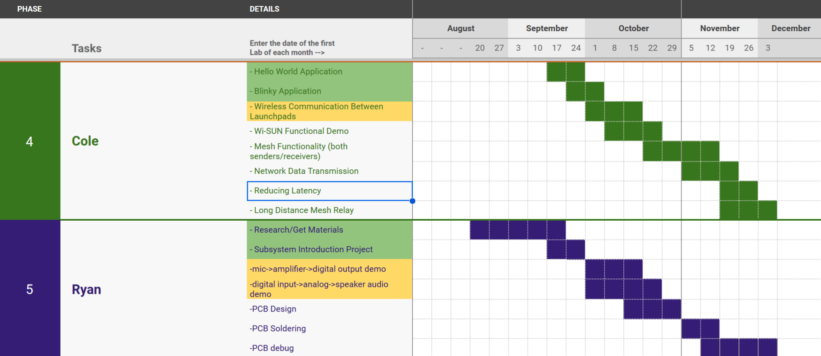
Execution Plan

Slide 13
Validation plan
Task | Specification | Result | Status | Owner
Battery Life Validation | Walkie Talkie operates for at least 24 hours on a rechargeable lithium battery | Battery operates for 24 hours under normal usage conditions. | UNTESTED | Junsu
Power Modes Validation | MCU implements active, standby, and shutdown modes. Standby mode enters when idle. | MCU successfully enters standby mode when not in use. Power usage is minimized in standby. | UNTESTED | Junsu
PCB-Power Distribution | PCB delivers appropriate power to each component (push-to-talk button, LED display, microphone, etc.). | Components receive correct voltage and current for operation. | UNTESTED | Ryan
Audio Input/Output | Microphone inputs audio, speaker outputs audio with clear and understandable quality. | Audio is recorded and played back through the speaker with minimal distortion. | UNTESTED | Ryan
Mesh Network Data Transmission | Transmit and receive equivalent-sized non-voice data packets between mesh devices. Latency <200ms. | Data packets transmitted and received between devices with <200ms latency. | UNTESTED | Cole
Long Distance Mesh Relay | Devices should relay communication to increase effective range (>100m). | Communication relays over a mesh network to extend range beyond 100m. | UNTESTED | Cole
Push-to-talk Functionality | LCD displays which device is talking, identified by unique MCU number. | The LCD correctly shows the active talker’s ID during transmission. | UNTESTED | Jaiah
Audio Compression (Opus Codec) | Compress digital audio using Opus Codec, ensuring understandable quality. Packet size < Wi-SUN limits. | Audio is compressed, within Wi-SUN packet size and bandwidth constraints. | UNTESTED | Jaiah

